Slide 1
Automata and Language Theory
Strings & Languages
Dr. Mohamed Nour

Slide 2
Regular Expression Terms
String
A string is a finite sequence of symbols. If w is a string, then the length of string is denoted by |w|, and it is defined as the number of symbols of w.
Example:
If w = “xyz”, then |w| = 3
If w = “” , then |w| = 0
Then the string is called an empty string, and Є is used to denote an empty string.
Alphabet
An alphabet is a finite set of symbols denoted by the symbol Σ. And the collection of all strings over Σ is denoted by Σ*.

Slide 3
Language
A language is a set of strings formed by using the symbols belonging to some previously chosen alphabet.
Example:
If Σ = {0, 1}, then one of the languages that can be defined over Σ is L = {Є , 0, 00, 000, 1, 11, 111, …. }
Σ = {a, b, c}
L = {abc,aabbcc,aaabbbccc,…}
Σ = {A, B, … , Z}
L = {CAT, BALL, SCHOOL, …}
Special Languages:
Φ – Empty Language
Є – Empty String

Slide 4
Thus,
A Regular Expression is a set of rules for constructing sequences of symbols (strings) from an Alphabet.
If Σ is an Alphabet, r a Regular Expression, then L(r) is the Language That is Characterized by the Rules of r.

Slide 5
Given an Alphabet Σ, the set of regular expressions is defined by
Є is a regular expression denoting {Є }
If a is in Σ , then a is a regular expression that denotes {a}
Let r and s be Regular Expressions denoting languages L(r) and L(s). Then
(r) | (s) is a regular expression L(r) ∪ L(s)
(r)(s) is a regular expression L(r) L(s)
(r)* is a regular expression (L(r))*
(r) is a regular expression L(r)
The precedence from highest to lowest:
a) The unary operator *
b) Concatenation
c) Union

Slide 6
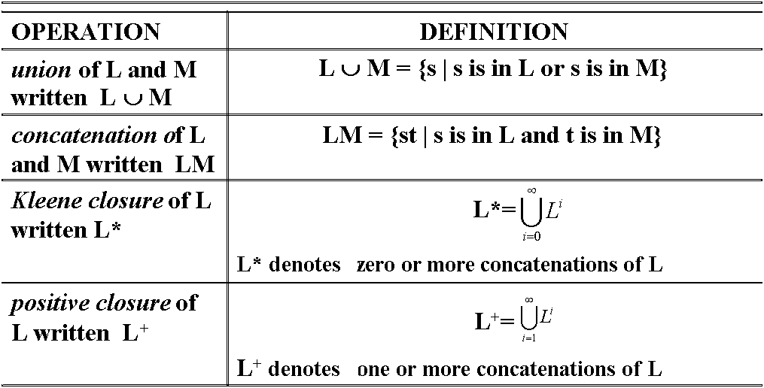
Operations over Languages

Slide 7
Algebraic Properties

Slide 8
Example:
If L = {A, B, C, D} and D = {1, 2, 3} then,
L ∪ D = {A, B, C, D, 1, 2, 3}
LD = {A1, A2, A3, B1, B2, B3, C1, C2, C3, D1, D2, D3}
L² = {AA, AB, AC, AD,
BA,BB, BC, BD,
CA, CB, CC, CD,
DA, DB, DC, DD}
L* = All possible strings of L + Є
L⁺ = L* - Є

Slide 9
Examples:
Let Σ = {a, b}
The regular expression r = a* defines the language consisting of all strings of zero or more a’s, that is:
L(r) = {Є, a, aa, aaa, aaaa, aaaaa, … }
2) The regular expression r = ab* defines the language consisting of all strings starting with a followed by zero or more b’s, that is:
L(r) = {a, ab, abb, abbb, abbbb, … }

Slide 10
Examples:
Let Σ = {a, b}
3) The regular expression r = a|a*b defines the language consisting of the string a and all strings of zero or more a’s and ending with b, that is:
L(r) = {a, b, ab, aab, aaab, aaaab, … }
4) The regular expression r = (a|b)(a|b) defines the language consisting of all strings of length two, that is:
L(r) = {aa, ab, ba, bb}
Another regular expression for the same language is:
aa|ab|ba|bb

Slide 11
Examples:
Let Σ = {a, b}
5) The regular expression r = (a|b)(a|b)(a|b) = (a|b)³ defines the language of all strings of length three, that is:
L(r) = {aaa, aab, aba, abb, baa, bab, bba, bbb}
6) The regular expression r = abb* = ab⁺ defines the language consisting of all strings starting with a followed by one or more b’s, that is:
L(r) = {ab, abb, abbb, abbbb, … }

Slide 12
Examples:
Let Σ = {a, b, c}
7) The regular expression r = ab*c defines the language of all strings that start with a followed by any number of b’s and then end with c, that is:
L(r) = {ac, abc, abbc, abbbc, abbbbc, … }
8) The regular expression r = (a|c)b(bb)* defines the language of all strings starting with a or c followed by odd number of b’s, that is:
L(r) = {ab, cb, abbb, cbbb, abbbbb, cbbbbb, … }

